Slide 1
Welcome! We are the T. Clay WoOd Elementary Reading Specialists
Mrs. Lauren Mack (K-2)
macklm@pwcs.edu
Mrs. Laura Fawley (3-5)
fawleyla@pwcs.edu

Slide 2
It is essential to have a daily time for reading at home.

Slide 3
To increase reading achievement and motivation:
Access to a wide variety of books: Children need access to a wide array of reading materials at their independent level in a variety of subject areas.
Well-stocked libraries: Book collections should contain current, interesting reading material. Keep visiting your local library.
Choice: Children need frequent opportunities to select their own reading materials for both personal and academic reasons.
Time to read: Children need consistent, daily time to read.
Reading engagement: Children need conditions that engage them with reading and foster reading self-efficacy.

Slide 4
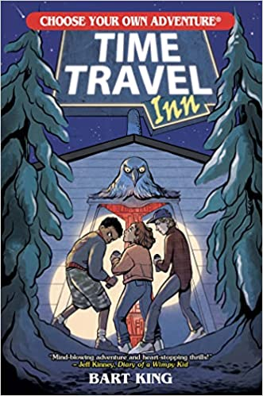
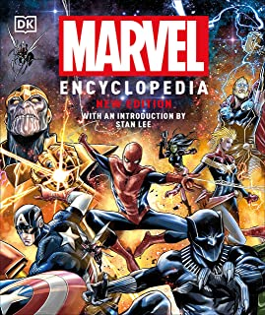
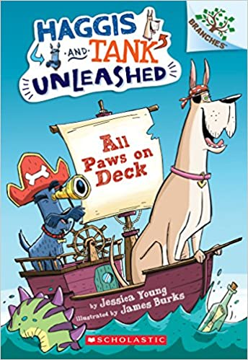
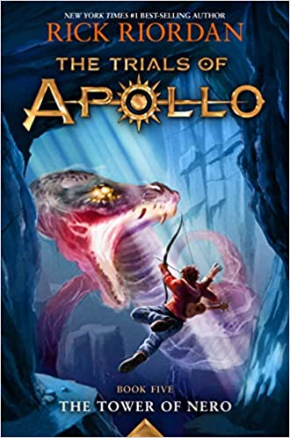
Exposure to a variety of genres helps increase vocabulary, listening comprehension, and understanding of text features.

Slide 5
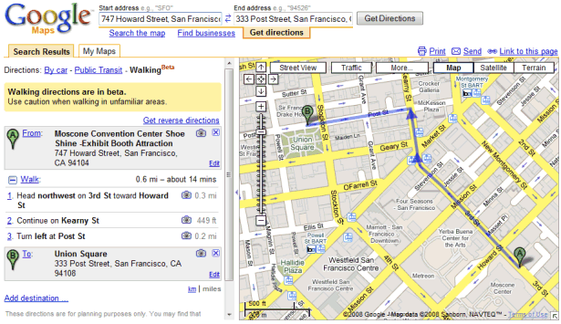
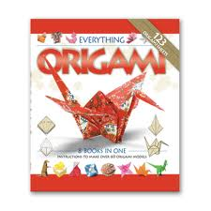
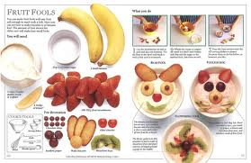
Most of what we read is “functional text.”

Slide 6
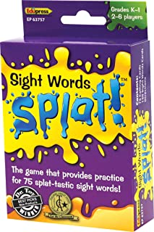
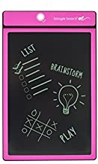
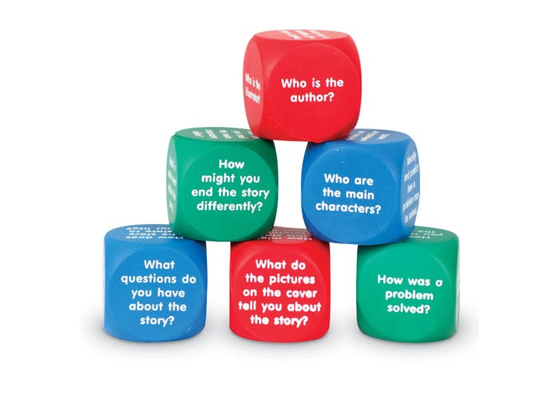
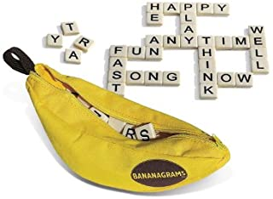
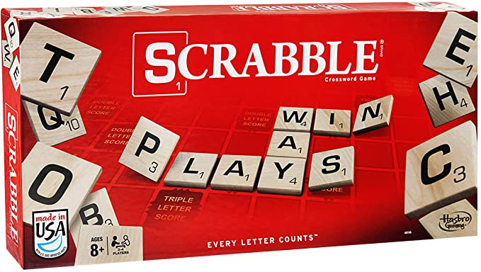
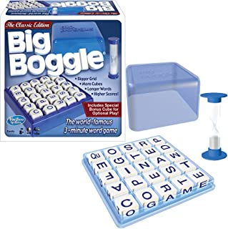
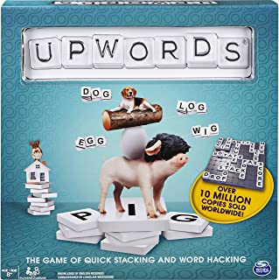
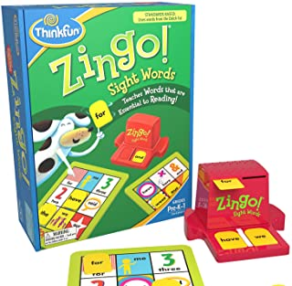
There are a lot of fun resources to help support sight words, sounds, word building, and letter recognition.
https://www.lakeshorelearning.com
http://www.amazon.com

Slide 7
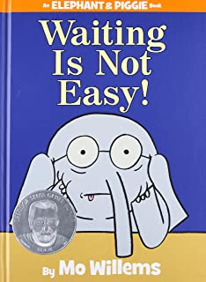
What IS
a “just right” book?
Your child should know or be able to figure out almost every word. Independent means 95%-100% accuracy. Reading for practice should be enjoyable, not stressful.

Slide 8
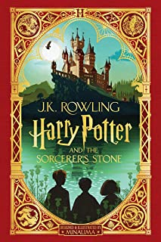
If it isn’t fun, then the text is probably too difficult for your child right now.
Tell your child that this is a “someday book.” They will be able to read it on their own someday, but for now maybe you can read it to them.

Slide 9
Why Read Aloud?
It presents books as sources of pleasant, valuable, and exciting experiences
Gives children background knowledge
Increases vocabulary
Allows parents to be good role models for what fluent reading sounds like
Encourages children to use their imagination

Slide 10
What can I do to help my child with comprehension?
Summarize – ask your child to retell the beginning, middle, and end of the story
S-T-P – Stop, Think, Paraphrase
Who –What – who is the most important character? What did he or she do?
Make Connections – what does this story remind you of?
Track the Character’s Feelings – how did the character feel at the beginning, middle, and end
Compare and Contrast
Problem and Solution

Slide 11
Thank you for coming!
Please feel free to reach out to us if you have questions or concerns.
Lauren Mack
macklm@pwcs.edu (K-2)
Laura Fawley
fawleyla@pwcs.edu (3-5)

